Slide 1
Understanding the difference between Member and Casual Users
Presented by: Zacharie Ndoumga
Last Update: 15.02.2022

Slide 2
Content
Objective
The Bigger Picture
Members v Casual riders
Observation
Propositions

Slide 3
Objective
Understand how riders with membership use the Cyclistic differently from casual users
Make Propositions how to convert casual riders into members

Slide 4
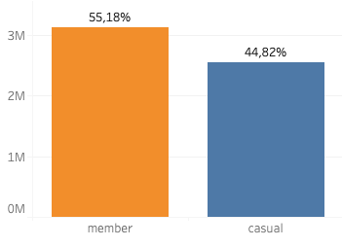
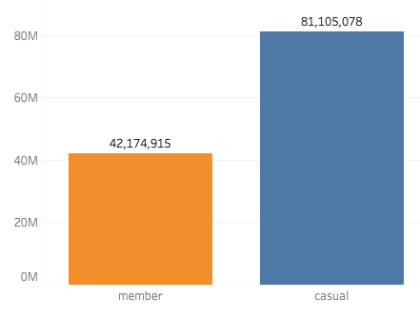
The bigger picture
Total Number of Rides
5.667.219
Total Ride Duration in Minutes
122.279.993
Number of rides
Total ride time

Slide 5
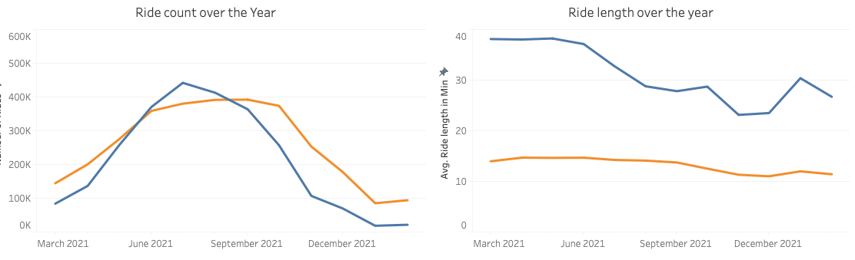
Differences during the year
Both peak during warmer periods (summer)
Casual users overtake members
Averagely, casual users ride longer, with higher numbers in spring and summer
Stays consistent throughout the year for members

Slide 6
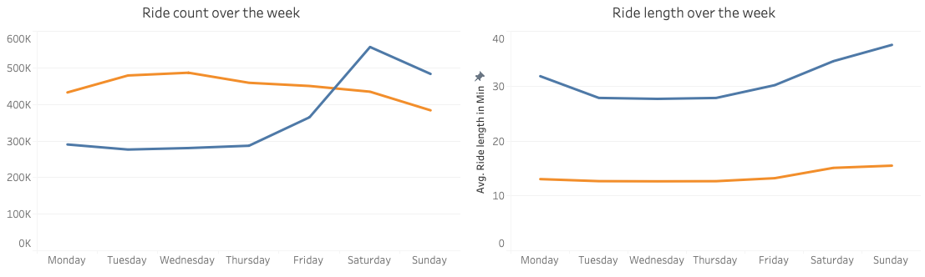
Differences during the week
Higher demand over the weekend for casual users
Relatively consistent throughout the week for members
Higher average ride lengths for casual members with slight increase during the weekend
Consistent ride lengths for member users

Slide 7
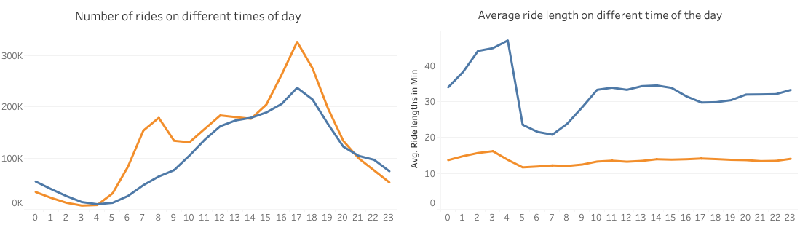
Differences during the day
Increasing demand during the day with peaks between 1pm-7pm
Morning and evening peaks for member users
Peak ride lengths during the night, dips in morning and consistent during the day
Stays consistent throughout the day for members

Slide 8
Observation
1
2
3
4
Casual riders make up 45% of rides but 65% of ride time. Varying ride length for casual users vs consistent for members
A general peak is observed during during warmer periods with casual riders overtaking members
A peak in ride is observed for casual users during the weekend and in the summer
Higher ride lengths are observed at night for casual users

Slide 9

Proposition
Introduce a half year membership program valid from April to October
Introduce an annual weekend membership program valid from friday to sunday
Introduce an annual half day membership program valid from 1pm-1am

